Slide 1
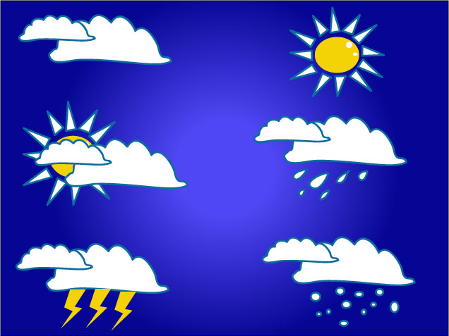
Duke of Edinburgh’s Award
Weather

Slide 2
Weather
(wet̸h′ər)
noun
the general condition of the atmosphere at a particular time and place, with regard to the temperature, moisture, cloudiness, etc.

Slide 3
Where to find out about it?
Internet – www.mwis.org.uk;
www.metoffice.gov.uk;
www.foreca.com
Tourist information
Mountain rescue bases
Newspapers
Television & radio
Look around!
Check the forecast as close to the time of the expedition as possible to obtain the most accurate information.

Slide 4
Weather systems
Air pressure determines wind and weather patterns.
High Pressure | Low Pressure
Warm in summer Cold in winter | Colder
Clear skies | Cloudy
Calm | Windy; unsettled
Sunny | Rain or snow

Slide 5
Signs indicating weather change
Temperature
Wind
Birds & animals
Clouds

Slide 6
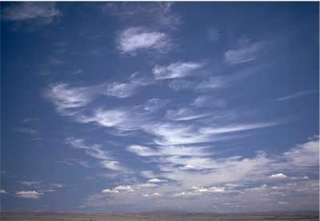
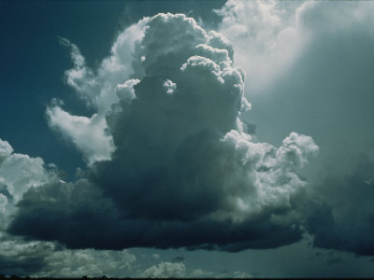
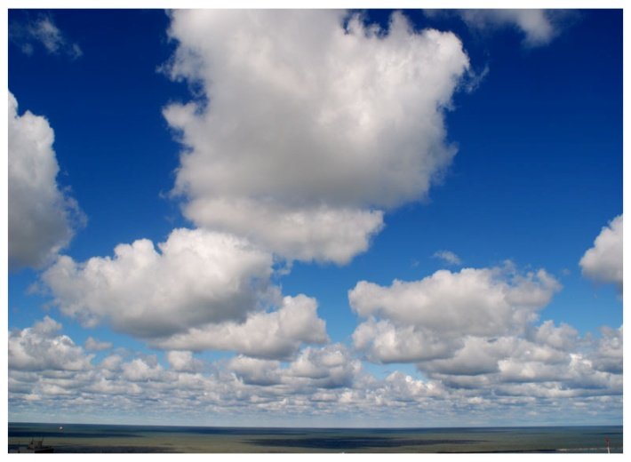
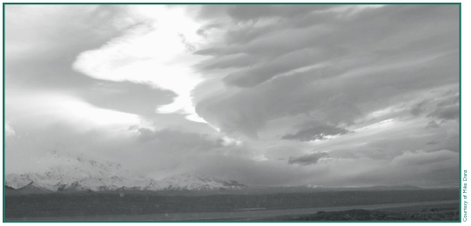
Basic cloud types
Cirrus - thin, wispy, curly-shaped clouds
Cumulo-nimbus- large, dense, towering clouds that cause rain and thunderstorms
Cumulus - puffy clouds
Stratus - Layered, horizontal clouds with a flat base

Slide 7
Read the Clouds
Cirrus clouds indicate fair weather in the immediate future – they can also be an indication of a change in weather within the next 24 hours.
Stratus are low-lying solid clouds they bring drizzle or light snow.
Cumulus clouds – if low clumps floating across the sky, there will be fair weather; vertical growth can indicate the start of a large storm.
Cumulonimbus clouds are cumulus clouds that have grown vertically. These clouds bring stormy weather such as rain, lightning and hail.

Slide 8
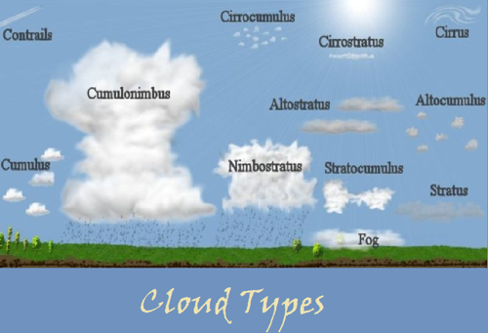

Slide 9
Relating forecasts to observed conditions
For every 100m of climb, the temperature will drop 1⁰C
Forecasts do not take account of wind chill
Hills are more likely to have their own micro-climate
High pressure:
Summer – protect yourself against the sun
Winter – wrap up warm
Low pressure:
Layers; wet weather gear

Slide 10
Thank you for listening
Any questions?

