Slide 1
DofE Gold Preparatory Map Skills
<<Your Name>>
D of E <<Your Position>>

Slide 2
Aim
To provide you with the basic knowledge regarding Ordinance Survey Maps that you will need in order for you to understand the information that the map contains

Slide 3
Method
Map familiarisation and Conventional Signs ;
OS Grid System;
North and Magnetic Variation;
Contours;
Scales and Distances;
Setting the Map.

Slide 4
OS Maps - Familiarisation
Every OS Map will have the following information:
Scale – 1:25,000 or 1:50,000
Name
Number – Series, Sheet, Edition
Date of Printing
Identifying Letters – i.e. NN
Magnetic Variation – Top/Centre and Bottom/Right
Scales – Metric, Imperial and Nautical
Conventional Signs

Slide 5
Grid North, Magnetic North and True North
There are three Norths commonly in use in Great Britain:
Grid North: the direction of a grid line which is parallel to the central meridian on the National Grid.
True North: the direction of a meridian of longitude which converges on the North Pole.
Magnetic North: the direction indicated by a magnetic compass. Magnetic North moves slowly with a variable rate and currently is west of Grid North in Great Britain.

Slide 6
Magnetic Variation
GRID to MAG – ADD
MAG to GRID – GET RID

Slide 7
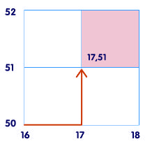
Four-Figure Grid Square
Each square has a grid reference which you get by putting together the numbers of the Easting and Northing that cross in its bottom left hand corner.

Slide 8
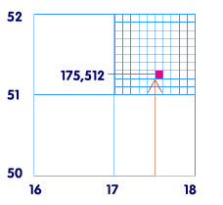
Six-Figure Grid Square
In your head, you should be able to divide all sides of the square into ten equal sections. By doing this, you can pinpoint locations within the square – these are
called six-figure grid references.

Slide 9
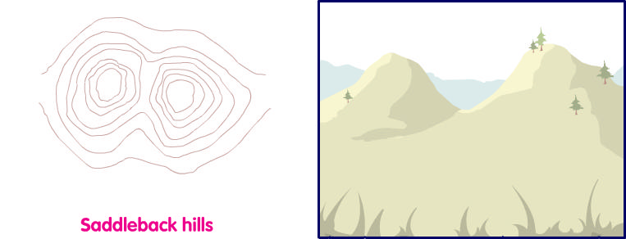
Contours
Contour lines are a map’s way of showing you how high the land is. They join together places of the same height and form patterns that help us to imagine what the land actually looks like.

Slide 10
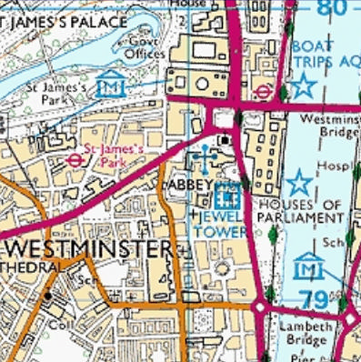
Scale
Scale is what makes map drawing possible. It takes real life things and reduces them in size many times so they can be shown on a map. Every map has a scale printed on the front and you should always check this figure before you start reading it. It will tell you how much smaller the area shown on the map is compared to the same area in real life.
1:25 000
This means that every one unit of measurement on the map (like a centimetre) is the same as 25 000 of those units (in this case 25 000 cm or 250 metres) in real life.

Slide 11
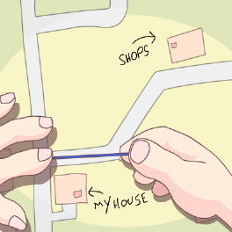
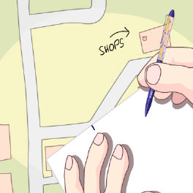
Measuring Distance – Step 1
Take a length of string (or a paper’s edge) – it's best to take one longer than you think you'll need – and place one end on your starting point.

Slide 12
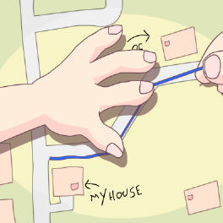
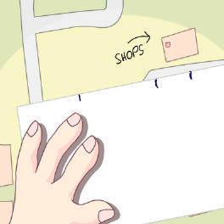
Step 2
Now carefully lay the string along the road or path you know you're going to use, following the curves as closely as you can. When you reach your finishing point, mark it on your string with a pen – or mark off the bends on the paper.

Slide 13
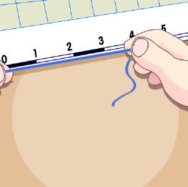
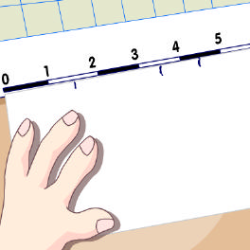
Step 3
Now that you have your distance from the map, you can straighten out your string and place it against the scale bar to find out how far you will actually be travelling – or dp the same with the paper.

Slide 14
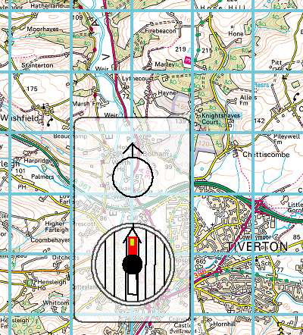
Setting a Map
*REMEMBER: The top of the map always points to north*
Line up the edge of the compass with the blue North/South grid lines on the map. Holding the compass firmly in this position with your thumb rotate yourself and the map around until the compass needle falls within the orienting needle on the base of the compass.

